Slide 1
APP Deployment of Classification Models on Heart Attack
Kefan Yu Wendi Chu Zifeng Xu

Slide 2
Agenda:
Background
Data & EDA
Model Selection & Training
Feature Importance & PCA
Limitations & Conclusions
APP Showcase

Slide 3
Background

Slide 4
Nowadays, people are paying more attention to their body health because many diseases can occur due to an unhealthy lifestyle. Among these diseases, heart attack/disease can be one of the most dangerous one. According to the CDC report, one person dies every 33 seconds in the United States from cardiovascular disease.
To address this concern, we conducted a study and developed an app that allows individuals to input their health indicator vectors. This app provides a result indicating whether they are at risk for heart attack/disease or not.
Reference: https://www.cdc.gov/heartdisease/facts.htm

Slide 5
Data & EDA

Slide 6
Data
Source: Kaggle (https://www.kaggle.com/code/alexteboul/heart-disease-health-indicators-dataset-notebook/notebook)
253,681 records & 21 Features + Target Variable (HeartDiseaseorAttack)

Slide 7
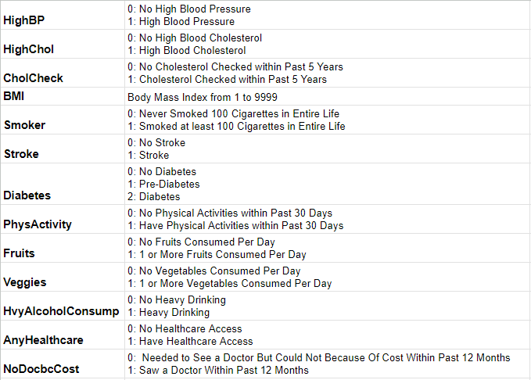
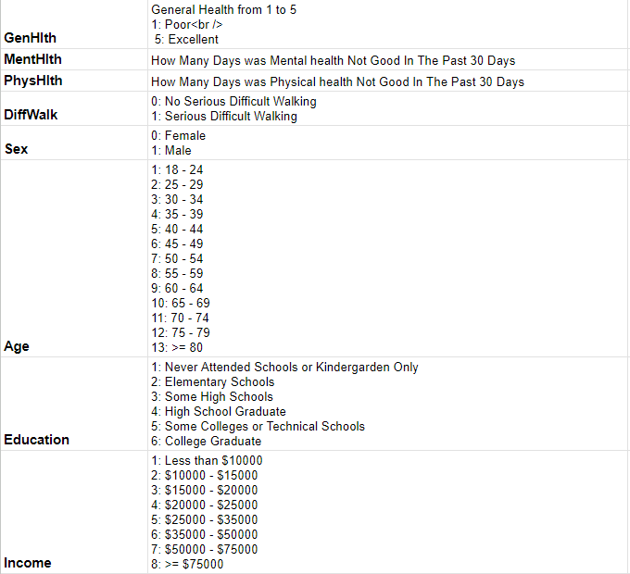

Slide 8
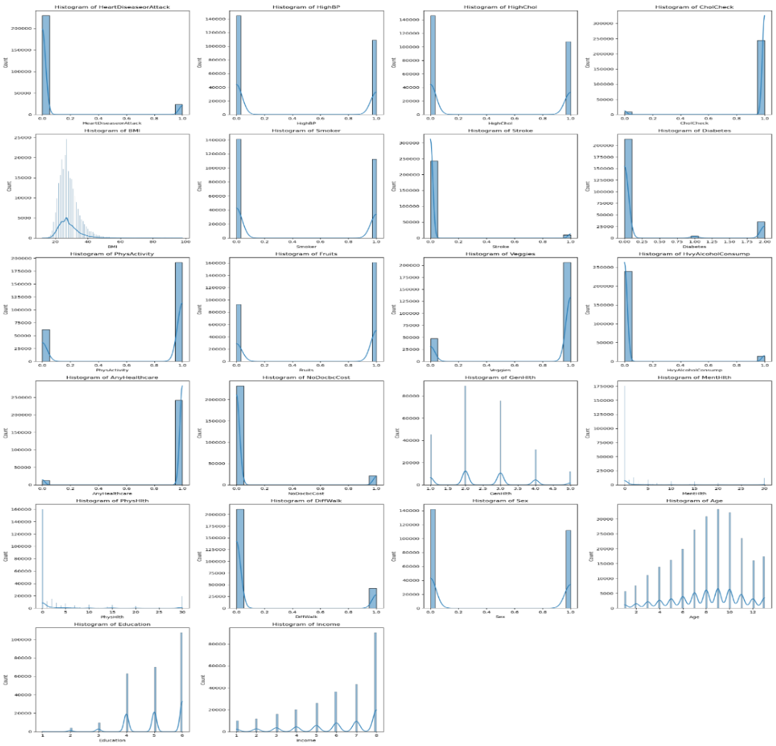

Slide 9
Model Selection & Training

Slide 10
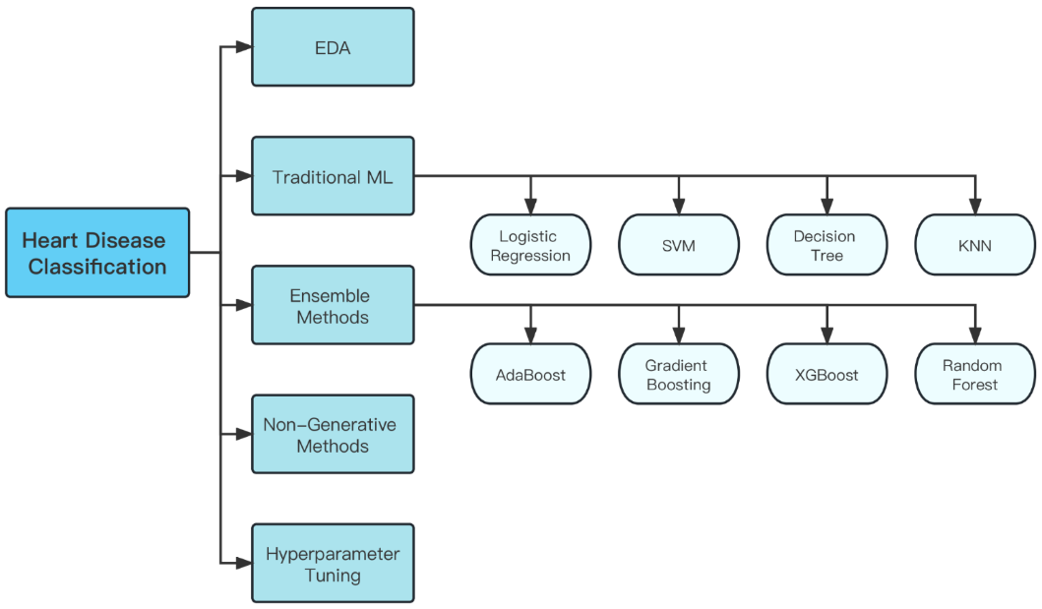
Notes:
The figure above shows the general workflow of our project. As you can see, we first do some simple EDA, and then use different model to train the data, and also do the hyperparameter tuning.

Slide 11
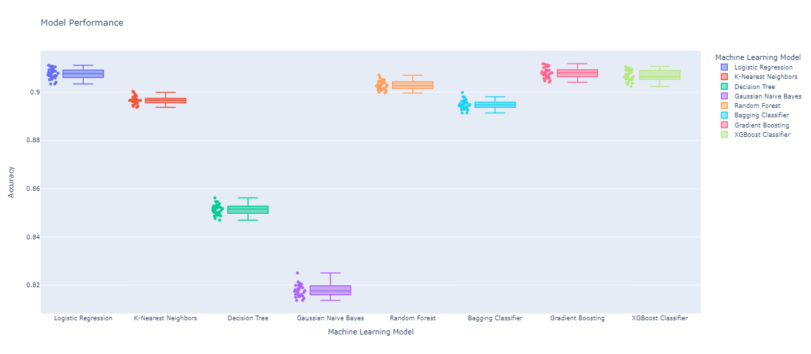
Model Selection
Notes:
Since our study focuses on predicting whether the patient got a heart disease or not, it is a classification problem. Therefore, we are going to perform the analysis using different classification methods, including Logistic Regression, K-Nearest Neighbors, decision trees, Gaussian Naive Bayes, Random Forest, Bagging Classifier, Gradient Boosting, and XGBoost Classifier.
We use 10-fold cross-validation to calculate the average cross validation accuracy scores, and then use the boxplot to demonstrate the performance of all these machine learning models.
According to the model performance, we choose Random Forest Classifier, Gradient Boosting Classifier and XGBoost Classifier as the candidate models for level 0 in the stacked classifier. And we use Logistic Regression as the level 1 model for this stacked classifier.

Slide 12
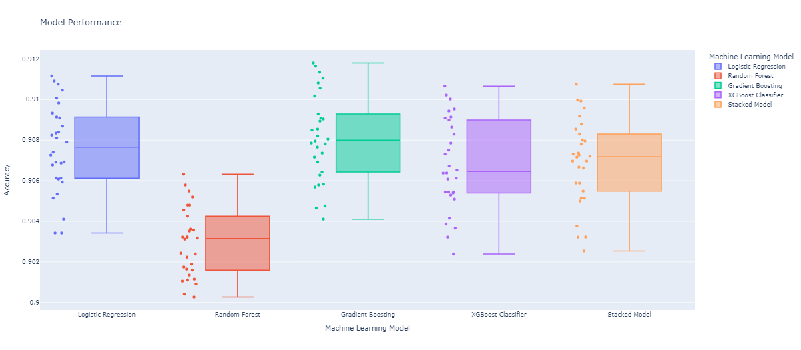
Stacked Model Performance
Notes:
From the result boxplot, We can see that the average accuracy score for the stacked model is better than Random Forest and XGBoost, however, it is worse than Logistic Regression and Gradient Boosting. But we still choose to save the stacked model as pickle and joblib file and continue to focus on analyzing the performance of the stacked model on the test dataset.

Slide 13
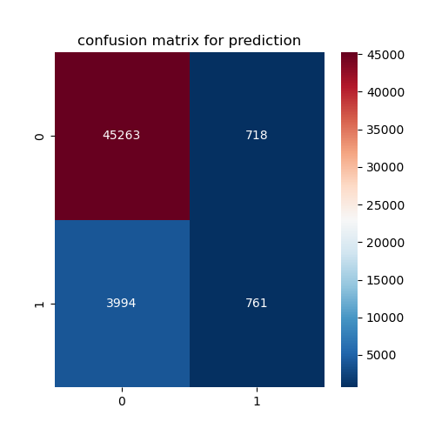
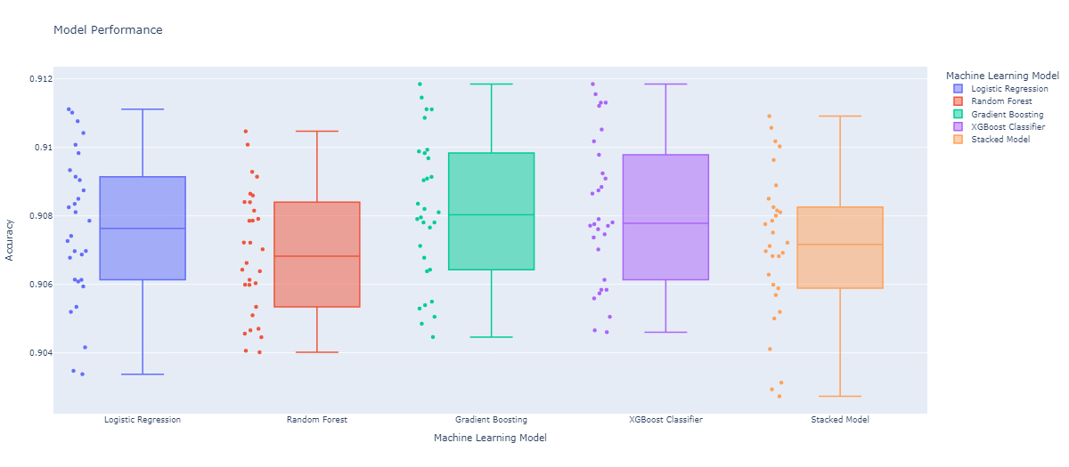
Hyperparameter Tuning and Accuracy
Notes:
We split the whole dataset into the training set and the test set based on the 80-20 ratio, and then plot a confusion matrix using the stacked model. The accuracy of this model on the test dataset is 0.91, which is acceptable. However, the recall of this model is pretty low, only around 0.3, that means we cannot successfully predict the positive patients.
Then we try to optimize the model using the Hyperparameter Tuning, but unfortunately, the general performance of the stack model is still not good enough, the accuracy increase a little bit, but the recall is still pretty low due to the dataset is very unbalanced. Therefore we choose to use the method of down sampling to make the dataset more balance to see whether it can improve the performance of our model.

Slide 14
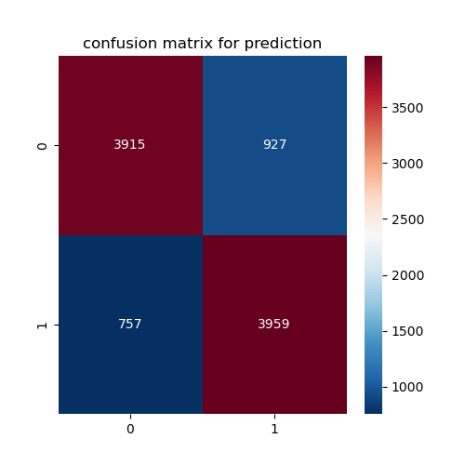
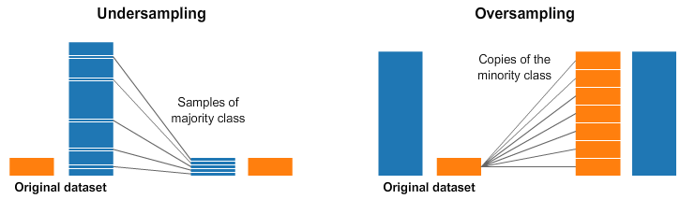
Resampling
Unbalance
Negative: 229787
Positive: 23893
Accuracy: 0.82
Recall: 0.84
Precision: 0.81

Slide 15
Feature Importance & PCA

Slide 16
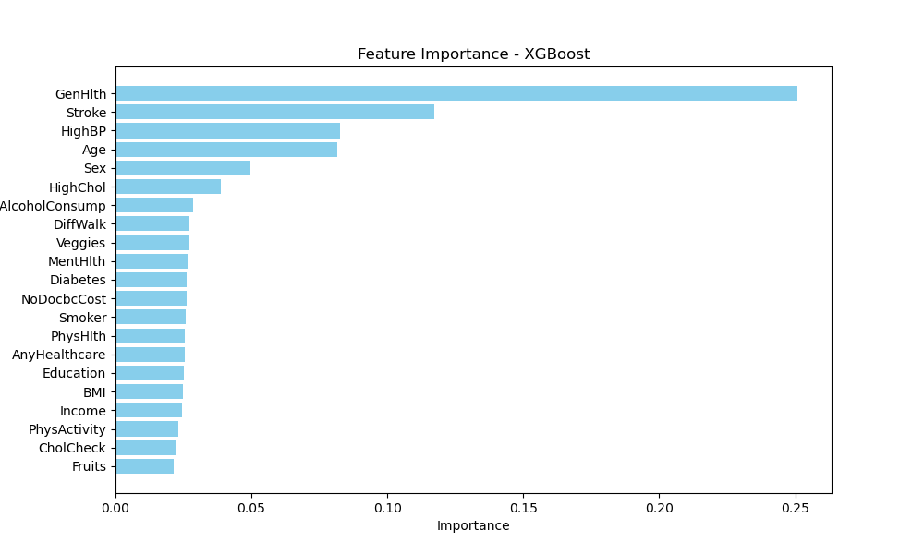
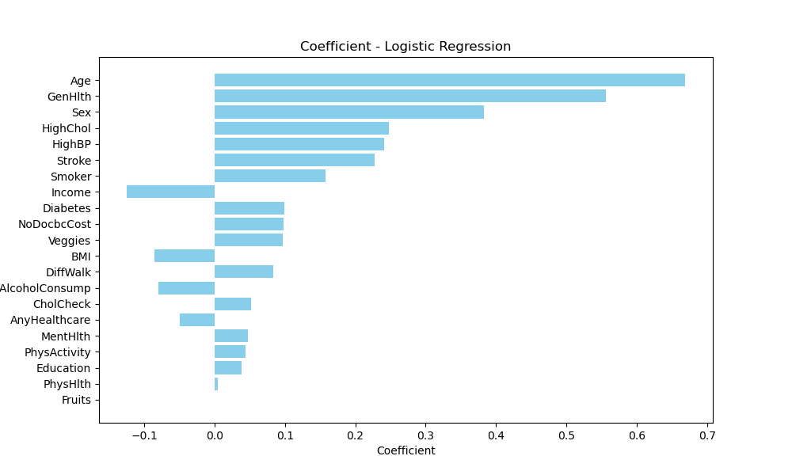
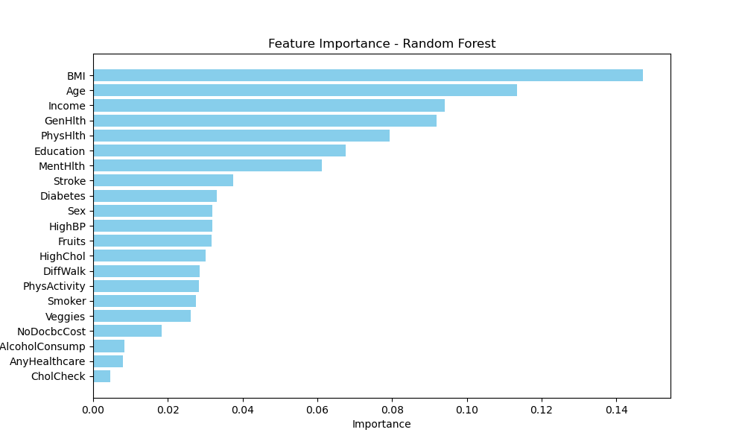
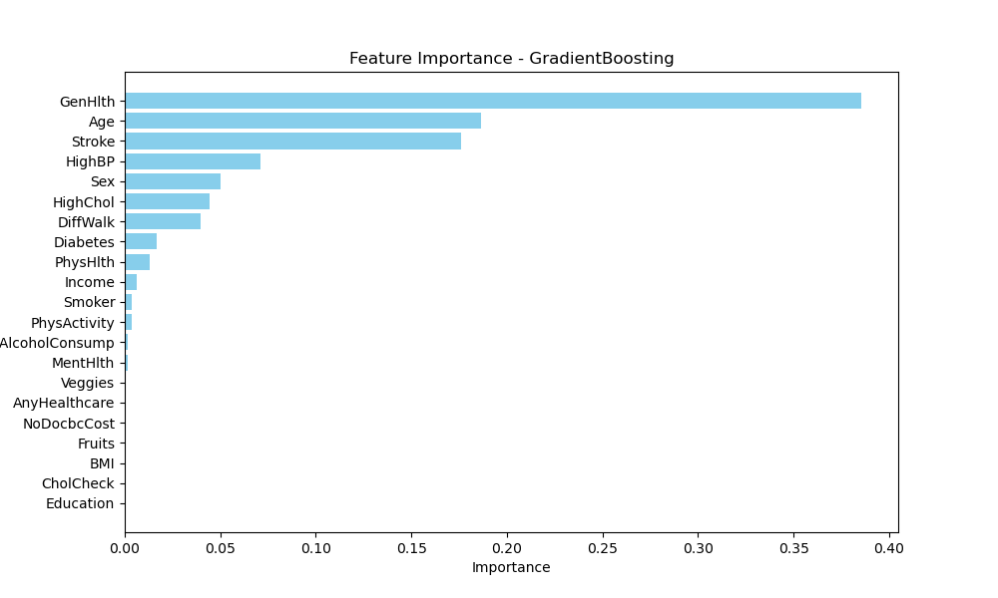
Feature Importance

Slide 17
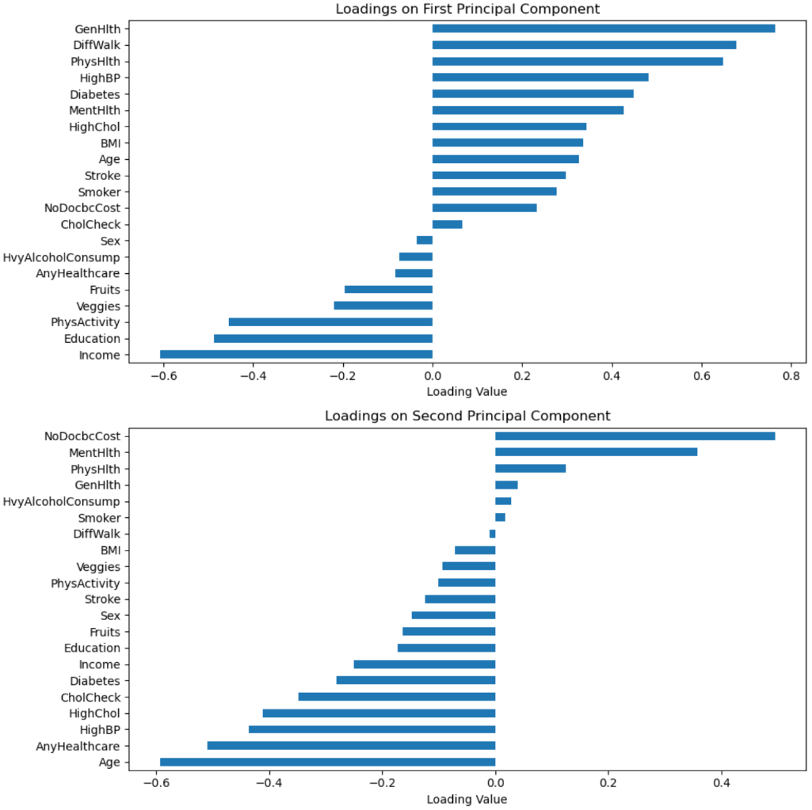
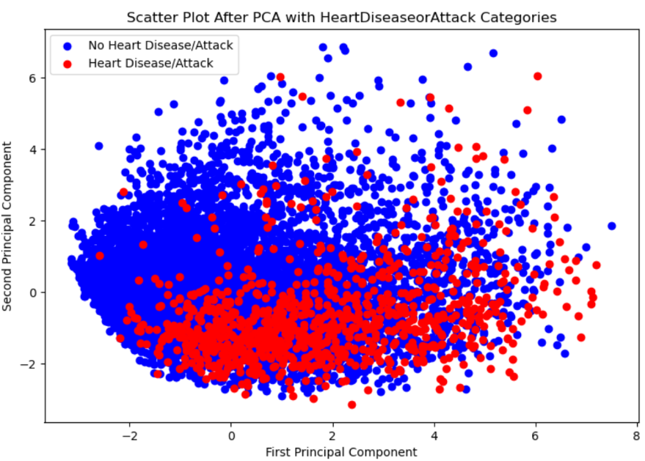
PCA

Slide 18
Limitations & Conclusions

Slide 19
Limitations
This dataset is extremely unbalanced, which impacts model predictions.
We downsample the dataset to prevent over-size of joblib file

Slide 20
Conclusions
Gradient Boosting Classifier achieves the highest accuracy
Use Logistic Regression, Random Forest Classifier, Gradient Boosting Classifier and XGBoost Classifier to build the stacked model
Undersampling method drastically increases the recall to 0.84
The accuracy of final stacked model is 0.82

Slide 21

APP Showcase

Slide 22
https://appanlyg06-3f43980c4ca5.herokuapp.com/
Unhealthy Person: [1.0,1.0,1.0,47.0,1.0,0.0,0.0,0.0,1.0,1.0,0.0,1.0,1.0,2.0,0.0,1.0,0.0,1.0,12.0,4.0,2.0]
Healthy Person:
[0.0,0.0,1.0,22.0,0.0,0.0,0.0,1.0,0.0,0.0,0.0,1.0,0.0,1.0,0.0,3.0,0.0,1.0,2.0,4.0,1.0]

Slide 23
Thank You!
Any Questions?
Kefan Yu: ky285@georgetown.edu
Wendi Chu: wc777@georgetown.edu
Zifeng Xu: zx111@georgetown.edu

